Slide 1
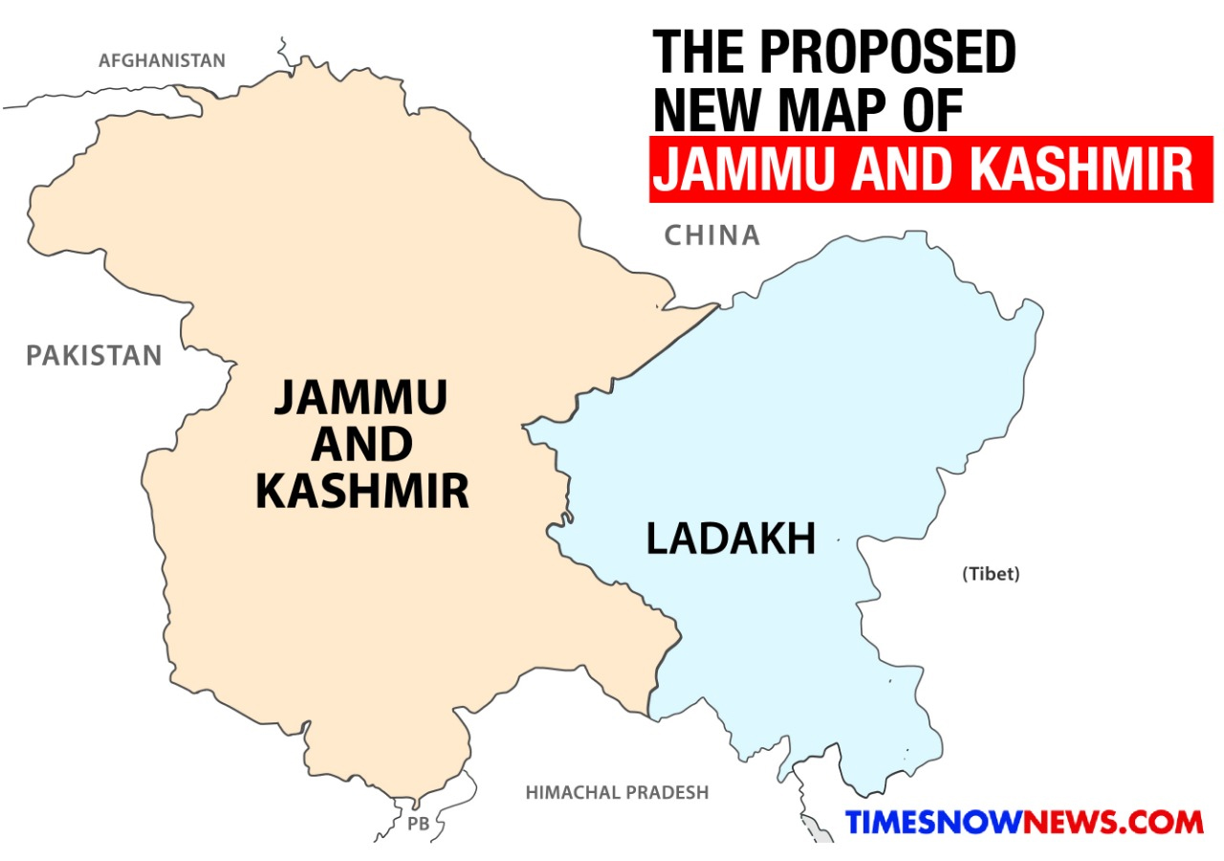
Constitution of J&K
The constitution was adopted on 17 November 1956.
It came into effect on 26 January 1957.
Jammu and Kashmir has a special status among Indian states.
the State of Jammu and Kashmir enjoyed a special but temporary autonomous status as mentioned in Part XXI of the Constitution of India.
till 1965, the head of state in Jammu and Kashmir was called Sadr-i-Riyasat (Head of State) whereas in other state, the title was Governor, and the head of government was called Prime Minister in place of Chief Minister in other states.

Slide 2
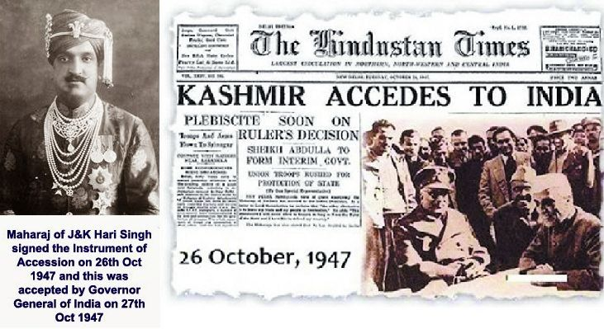
Historical Aspect
J&K chose to remain independent at the time of India, Pakistan Independence.
An agreement was entered by J&K with Pakistan and India that none of them will attack J&K. While India respected the agreement and exercised restraint, Pakistan attacked Kashmir in a bid to annex it by force.
On 6th October 1947, Kashmir was attacked by “Azad Kashmir Forces” supported by Pakistan. To save J&K, the then ruler Maharaja Hari Singh chose to accede J&K to India.
In October 1947, the accession was made by the ruler in favour of India in consideration of certain commitments made by Pt. Jawahar Lal Nehru (the then Prime Minister of India). It was in the pursuance of those commitments that Article 370 was incorporated in the Constitution.
The Ruler of Jammu and Kashmir signed the instrument of accession whereby only three subjects were surrendered by the State to the Dominion of India.
1. External affairs 2. Defense and 3. Communications

Slide 3
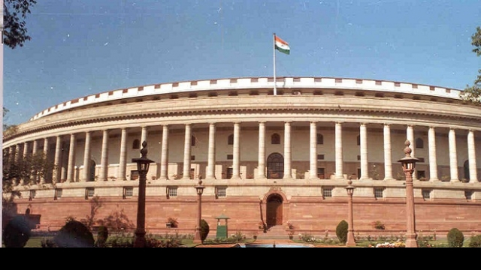
Jurisdiction of Parliament
Limited jurisdiction in case of J&K as compared to other states.
Till 1963, Parliament could legislate on subjects contained in the Union List, and had no jurisdiction in case of Concurrent List under 7th Schedule of the Constitution. But now, the Parliament has power to legislate not just on subjects contained in the Union List but also on some of the subjects of Concurrent List.
Residuary powers, unlike other states, rest with J&K.
The Parliament has no power to legislate Preventive Detention laws for the state; only the state legislature has the power to do so.

Slide 4
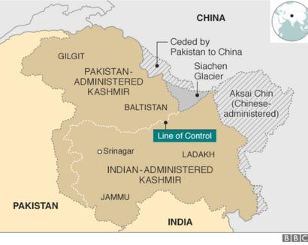
The State enjoys a greater measure of autonomy and the power of the Union of India is restricted, as regards other States.
The Union of India is incompetent to declare financial emergency and emergency in case of failing of constitutional machinery with respect to the State of J&K.
Only emergency due to War or External Aggression can be declared as it is within the scope of “Defense” as surrendered to the Union of India.

Slide 5
Temporary provisions
(1) Notwithstanding anything contained in this Constitution,—
(a) the provisions of article 238 shall not apply now in relation to the state of Jammu and Kashmir
(b) the power of Parliament to make laws for the said state shall be limited to—
(i) those matters in the Union List and the Concurrent List which, in consultation with the Government of the State, are declared by the President to correspond to matters specified in the Instrument of Accession governing the accession of the State to the Dominion of India as the matters with respect to which the Dominion Legislature may make laws for that State; and
(ii) such other matters in the said Lists as, with the concurrence of the Government of the State, the President may by order specify.
(c) the provisions of article 1 and of this article shall apply in relation to that State;
(d) such of the other provisions of this Constitution shall apply in relation to that State subject to such exceptions and modifications as the President may by order specify: Provided that no such order which relates to the matters specified in the Instrument of Accession of the State referred to in paragraph (i) of sub-clause (b) shall be issued except in consultation with the Government of the State:
(2) If the concurrence of the Government of the State referred to in paragraph (ii) of sub-clause (b) of clause (1) or in the second provision to sub-clause (d) of that clause be given before the Constituent Assembly for the purpose of framing the Constitution of the State is convened, it shall be placed before such Assembly for such decision as it may take thereon.
(3) Notwithstanding anything in the foregoing provisions of this article, the President may, by public notification, declare that this article shall cease to be operative or shall be operative only with such exceptions and modifications and from such date as he may specify:
Provided that the recommendation of the Constituent Assembly of the State referred to in clause (2) shall be necessary before the President issues such a notification.

Slide 6
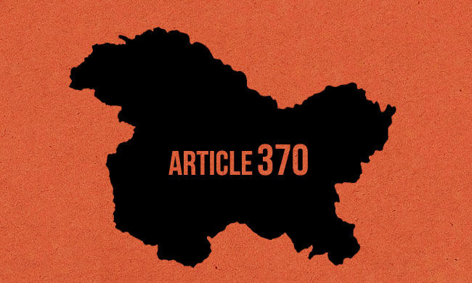
Special Provisions
Article 370 embodied six special provisions for Jammu and Kashmir:
It exempted the State from the complete applicability of the Constitution of India. The State was conferred with the power to have its own Constitution.
Central legislative powers over the State were limited, at the time of framing, to the three subjects of defence, foreign affairs and communications.
Other constitutional powers of the Central Government could be extended to the State only with the concurrence of the State Government.
The 'concurrence' was only provisional. It had to be ratified by the State's Constituent Assembly.
The State Government's authority to give 'concurrence' lasted only until the State Constituent Assembly was convened. Once the State Constituent Assembly finalised the scheme of powers and dispersed, no further extension of powers was possible.
Article 370 could be abrogated or amended only upon the recommendation of the State's Constituent Assembly.

Slide 7
Emergency Provisions
The Union of India has no power to declare Financial Emergency under Article 360 in the state.
The Union can declare emergency in the state only in case of War or External Aggression.
No proclamation of emergency made on the grounds of internal disturbance or imminent danger thereof shall have effect in relation to the state unless
it is made at the request or with the concurrence of the government of the state; or
where it has not been so made, it is applied subsequently by the President to that state at the request or with the concurrence of the government of that state.

Slide 8
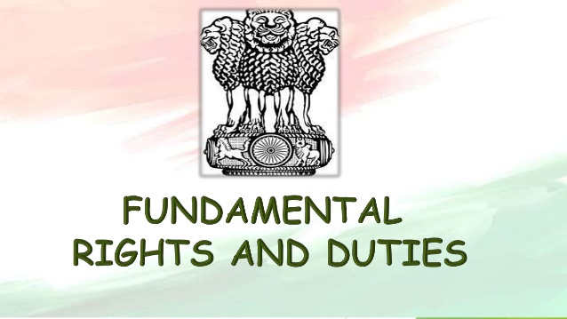
Fundamental duties, directive principles and fundamental rights
Part IV (Directive Principles of the State Policy) and Part IVA (Fundamental Duties) of the Constitution are not applicable to J&K.
Part III- (Fundamental Rights) In addition to other fundamental rights, Articles 19(1)(f) and 31(2) of the Constitution are still applicable to J&K; hence the Fundamental Right to property is still guaranteed in this state.
Certain special rights have been granted to the permanent residents of J&K with regard to employment under the state, acquisition of immovable property in the state, settlement in the state, and scholarship and other forms of aid as the state government may provide.
The 5th Schedule pertaining to the administration and control of Schedule Areas and Scheduled Tribes and the 6th Schedule pertaining to administration of tribal areas are not applicable to the state of J&K.

Slide 9
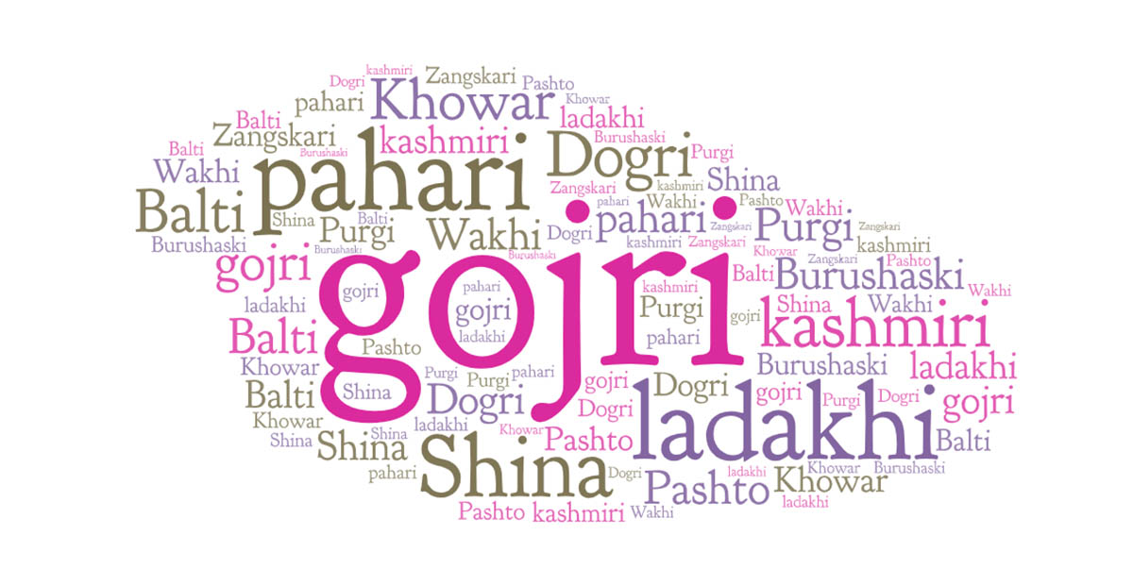
Official languages
Provisions of Part XVII of the Constitution apply to J&K only insofar as they relate to,
(i) the official language of the Union;
(ii) the official language for communication between one state and another; or between a state and the Union; and
(iii) language of the proceedings in the Supreme Court.
Urdu is the official language of the state but use of English is permitted for official purposes unless the state legislature provides otherwise.

Slide 10
Autonomy of Jammu and Kashmir
Any action of the Union Legislature or Union Executive which results in alteration of the name or territories or an international treaty or agreement affecting the disposition of any part of the territory of the state requires the consent of the State Legislature or the State Executive (as the case may be) to be effective.
The Union has no power to suspend the Constitution of J&K.
The subjects for legislation are divided into a 'Union List’ of ninety six subjects, a 'State List ‘of sixty six items, and a 'Concurrent List’ of fourty seven items.
ninety-four of the ninety-seven items in the Union List applied to Jammu and Kashmir. Of the 'Concurrent List', twenty-six of the forty-seven items applied to Jammu and Kashmir

Slide 11
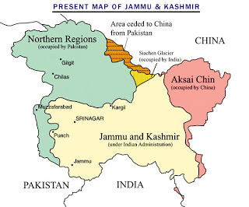
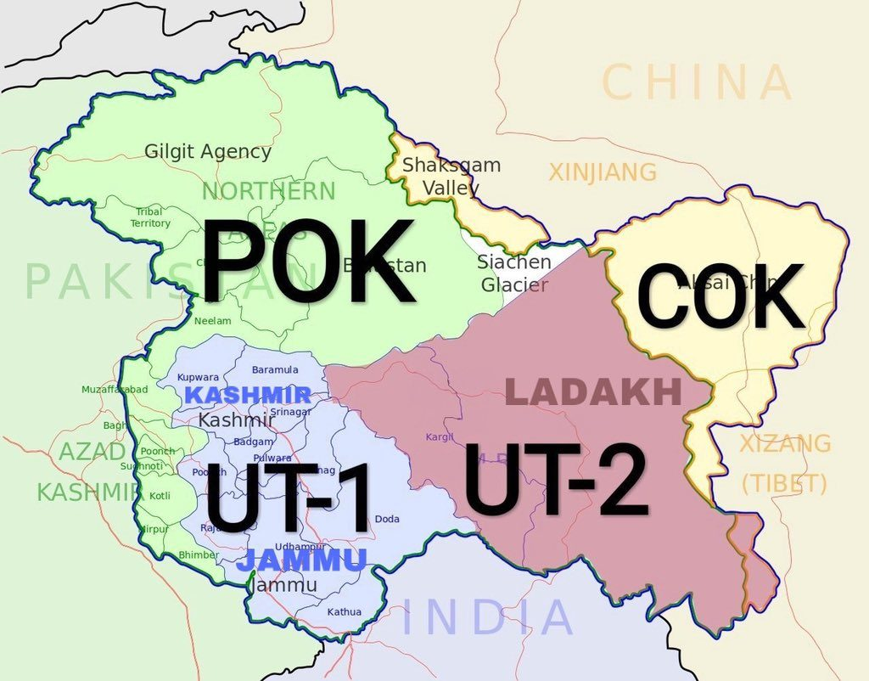
Relation Of Kashmir
Article 3 in part 2 of the Jammu and Kashmir constitution stated "Relationship of the State with the Union of India:-The State of Jammu and Kashmir is and shall be an integral part of the Union of India."
Article 5 of the part 2 was about extent of "Executive" and "Legislative" powers of the state and stated that "Jammu and Kashmir Legislative Assembly has executive and legislative power of all matters except those with respect to which Parliament of India has power to make laws for the State under the provisions of the Constitution of India".^{[9]} Sectors in which Government of India can make laws for Jammu and Kashmir includes Defense sector, Foreign affairs, Finance and Communication.
Article 147 of Part 12 was about amendment of the Jammu and Kashmir Constitution which stated that, "No Bill shall be introduced or moved in State Legislative Assembly to amend or change above mentioned articles 3 and 5
Article 48 of Part VI of Jammu and Kashmir constitution defines Pakistan administered Kashmir as "Pakistan Occupied Territory" (POK).^{[12]}
There were 111 seats in Jammu and Kashmir state legislative assembly. Of these seats, 24 were reserved for representatives from Pakistan-controlled Kashmir, to remain vacant until Pakistan ceases the "occupation" of Kashmir

Slide 12
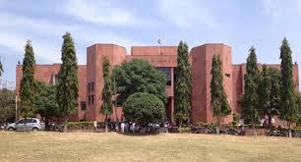
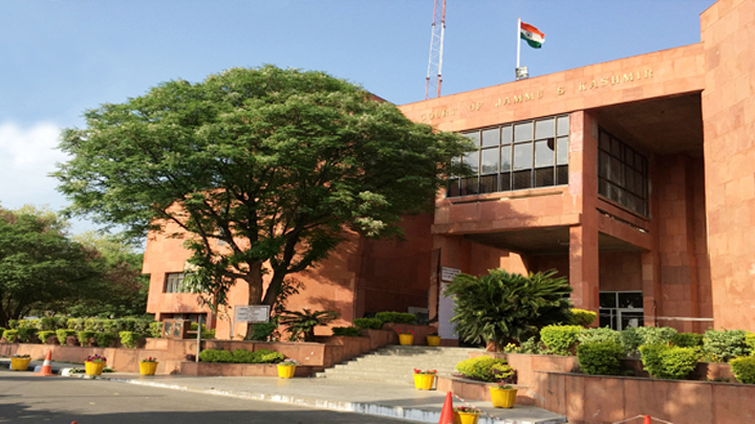
High Court Of J&K
The High Court of J&K has limited powers as compared to other High Courts within India. It can’t declare any law unconstitutional.
Unlike High Courts in other states, under Article 226 of the Constitution, it can’t issue writs except for enforcement of Fundamental Rights.

Slide 13
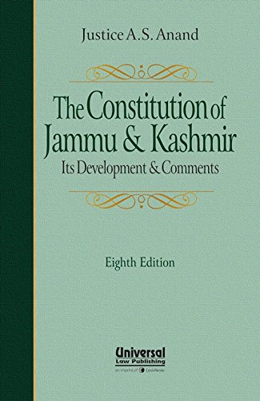
Amendment Of State Constitution
The Provisions of the State Constitution (except those relating to the relationship of the state with the Union) may be amended by an Act of the Legislative Assembly of the state passed by not less than two-thirds of its membership.
If such amendment seeks to affect Governor or Election Commission, it needs President’s assent to come into effect. No amendment of the Constitution of India shall extend to J&K unless so extended by an order of the President under Article 370(1).
No bill or amendment can be introduced or moved in either House of the Legislature which seeks to make any change in the provisions which is not applicable to the state or which do not extend to matters those with respect to which Parliament has power to make laws for the State under the provisions of the Constitution of India.

